Slide 1
CS 7643: Deep Learning
Assignment 2 Overview

Slide 2
A2 Overview
Part 1: Convolutional neural networks from scratch
Part 2: CNNs with PyTorch + experiments
Part 3 & 4: Class imbalance and focal loss
Deliverables:
Code (Gradescope Autograder): 72 points
Report (Gradescope): 28 points

Slide 3
Part 1: CNN from scratch
Implement modules / layers:
Convolution
Max Pooling
ReLU
Linear
Implement optimizer:
SGD with momentum

Slide 4
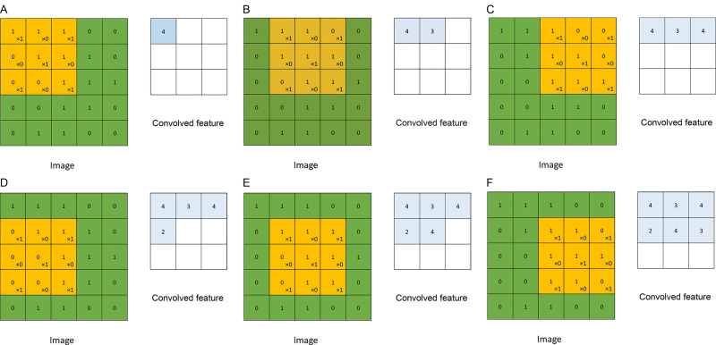
Cross-correlation (or convolution)
https://www.sciencedirect.com/topics/mathematics/convolutional-layer
Notes:
What are new spatial dims.

Slide 5
Vectorizing
Ok to use loops for A2.
Vectorizing is not necessary for A2 but in practice its important.
Note Convolutional layers are just linear transform of kernel (weights) with different “views” of the image. Ie. toeplitz matrix
Use this notion to vectorize.

Slide 6
Vectorization: Stride tricks (1 of 2)
Goal: create views of an image the same size as the filters we’re applying:
(c, h, w) → (h_new, w_new, c, k, k)
Given an image A as a numpy array:
A.shape = (c, h, w) = (3, 45, 40)
Assuming A is of type float64, its strides from numpy are
A.strides = (s_c, s_h, s_w) = (14400, 320, 8)
Strides represent how many bytes of offset to get to the next value in that dimension.
45×40×8 bytes per stride
40×8 bytes per stride
8 bytes per stride

Slide 7
Vectorization: Stride tricks (2 of 2)
In preparation for a convolution layer, we want to create “views” of the image with the same size as the filter. Assuming filter size k=3 and stride stride=2, we have:
h_new = (45 - 3) // 2 + 1 = 22
w_new = (40 - 3) // 2 + 1 = 19
np.lib.stride_tricks.as_strided(
A,
shape=(22, 19, 3, k, k),
strides=(s_h*2, s_w*2, s_c, s_h, s_w),
writeable=False
)

Slide 8
Vectorization: Multiplying tensors
As an example, given matrices
A of shape (n, c, h, w) → containing n images
B of shape (c, h, w, k) → containing filters the same size as image
How to apply the filters to all the images at once?
Method 1
np.tensordot(A, B, axes=3)
Method 2
np.einsum(‘nchw,chwk->nk’, A, B)

Slide 9
Vectorization: Broadcasting
Given two matrices, add them together along a specific dimension:
A is of size (a, b, c)
B is of size (b,)
This can be done by
A + B[:, np.newaxis] Or A + B[:, None]
This tells numpy to broadcast across the 1st and 3rd dimensions before performing addition.

Slide 10
Vectorization: Unravel Index
How to retrieve the location of a point given the argmax?
A = np.array([[ 3, 5],
[17, 2],
[16, 3]])
i = A.argmax() = 2
np.unravel_index(i, A.shape) = (1, 0)

Slide 11
Part 2:
Complete the training loop of PyTorch (notice the difference between training and validation)
Implement two specified models
Two fully connected layers with a sigmoid activation function in between
Vanilla CNN
Implement your own model

Slide 12
Complete the training loop of PyTorch
Implement the training and validation step utilizing PyTorch
Key concept is that in validation you won't be updating the gradients

Slide 13
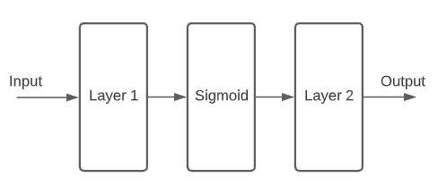
Two Layer Model - PyTorch
Two fully connected layers with a sigmoid activation function in between

Slide 14
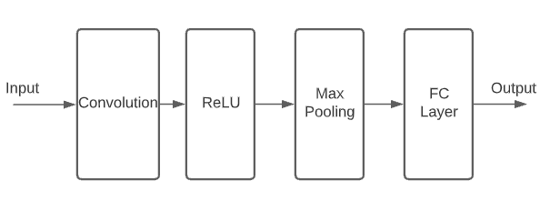
CNN - PyTorch
Implement a basic CNN utilizing PyTorch

Slide 15
Own Model Implementation Requirements
Your accuracy on test data needs to be above 0.5 to receive partial credits. For full credit you need above 0.8.
You must upload the checkpoint because gradescope won't be able to train your model
The script will create and save the checkpoints for you.
If you make your model too deep then gradescope might timeout as there is a limit for runtime + size (10 min for all tests, 100 mb filesize)
You can utilize your own model selection. Take inspiration from architecture design discussed in lecture.

Slide 16
Part 3:
Given an imbalanced dataset:
baseline vanilla CE loss performance.
Experiment with methods accounting for class imbalance.
Implement/Experiment with two methods provided:
Use the resnet implementation we provide.
Focal loss
Class-balanced Loss (use with Focal Loss)
No local/gradescope tests
Up to you to understand/implement concepts from the papers.
CB-loss paper highlights Multi-label classification. Do not be fooled by this!
This is different than Multiclass classification. Make sure you read it carefully.

